Slide 1
Lesson 4: Pandas

Slide 2
Getting Started with Pandas
Pandas is an open-source Python Library providing high-performance data manipulation
and analysis tool using its powerful data structures.
Using Pandas, we can accomplish five typical steps in the processing and analysis of data,
regardless of the origin of data
Load
Prepare
Manipulate
Model
Analyze.
Python with Pandas is used in a wide range of fields including academic and commercial domains including nance, economics, Statistics, analytics, etc.

Slide 3
Pandas Data Structure

Slide 4
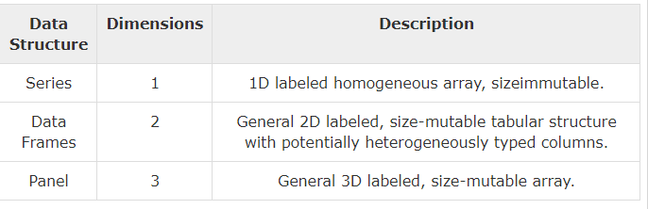
Pandas Data structures
Pandas deals with the following three data structures
Series
DataFrame
Panel
These data structures are built on top of Numpy array, which means they are fast.
Mutability: All Pandas data structures are value mutable (can be changed) and except
Series all are size mutable. Series is size immutable.

Slide 5
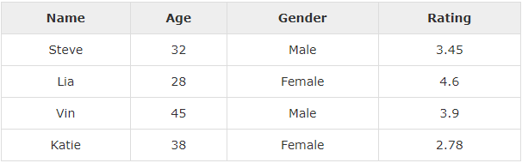
Series and DataFrames(*) in Pandas
Series is a one-dimensional array like structure with homogeneous data.
For example, the following series is a collection of integers.
DataFrame is a two-dimensional array with heterogeneous data. For example
DataFrames are the central concept in pandas. In essence, a data frame is table with
labeled rows and columns.
Data frames can be created from multiple sources - e.g. CSV files, excel files and JSON.

Slide 6
Creating a DataFrame
Hardcoded DataFrames
Loading CSV files

Slide 7
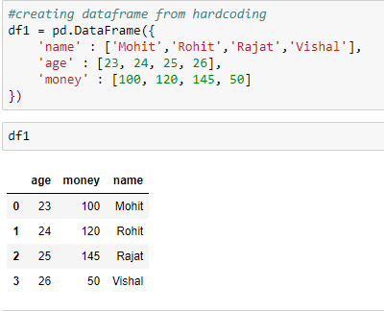
Creating a DataFrame
Hardcoded DataFrames: Hardcoded data frames can be constructed by providing a hash of columns and their values.

Slide 8
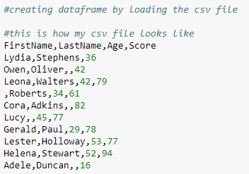
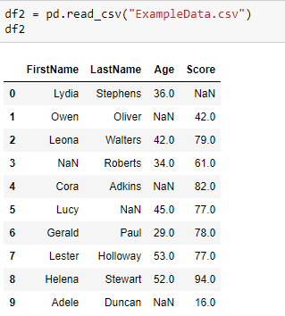
Creating a DataFrame
2. Loading CSV files:
Let's say you have the following table in form of csv in the system as “example.csv".

Slide 9
DataFrame Basic Functionality

Slide 10
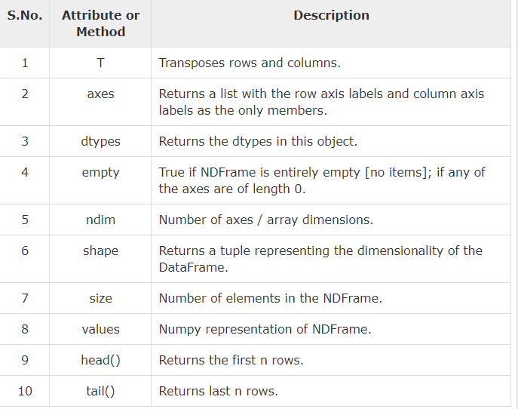

Slide 11
Working Examples

Slide 12
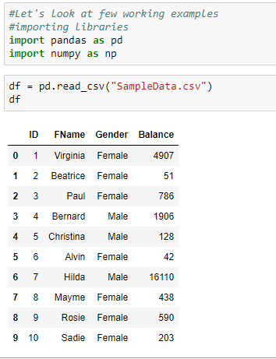
Working examples

Slide 13
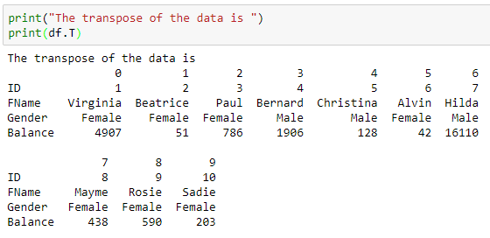
Transpose.
Returns the transpose of the DataFrame. The rows and columns will interchange

Slide 14
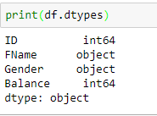




axes, dtypes, len, columns, shape and to_csv

Slide 15
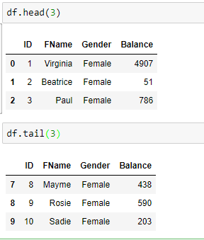
Head & Tail
To view a small sample of a DataFrame object, use the head() and tail() methods.
head() returns the first n rows (observe the index values). The default number of elements to display is five, but you may pass a custom number.
tail() returns the last n rows (observe the index values). The default number of elements to display is five, but you may pass a custom number.

Slide 16
Understanding Column

Slide 17
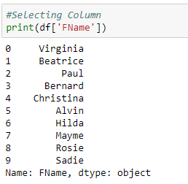
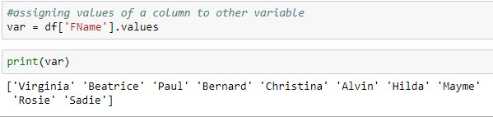
Selecting columns from dataframes

Slide 18
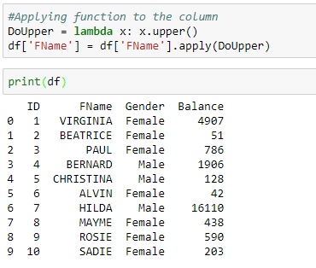
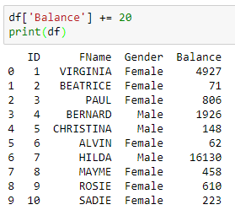
Applying functions to columns

Slide 19
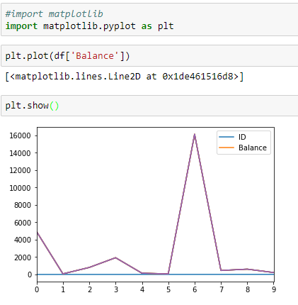
Plotting a column

Slide 20
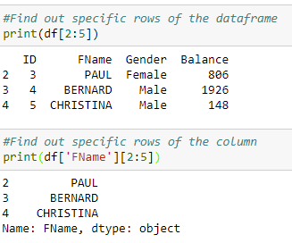
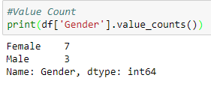
Slicing of DataFrame and Value Count

Slide 21
Slicing of DataFrame

Slide 22
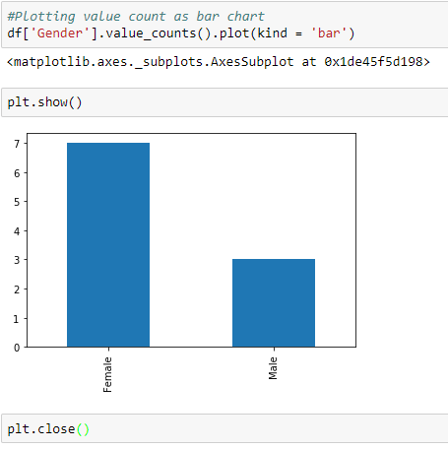
Value Count

Slide 23
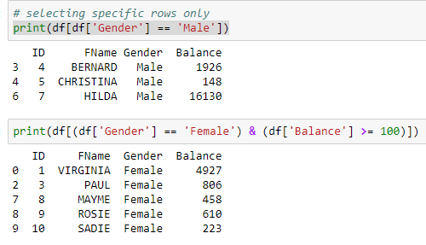
Selecting rows where column has a particular value

Slide 24
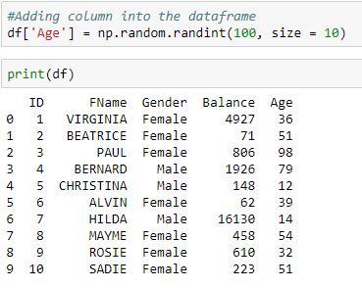
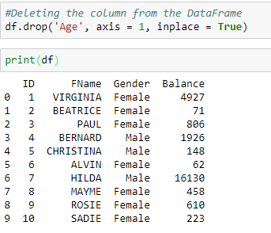
Adding/Deleting column into the DataFrame

Slide 25
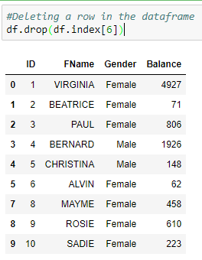
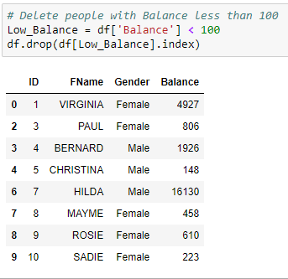
Deleting Rows

Slide 26
Descriptive Statistics

Slide 27
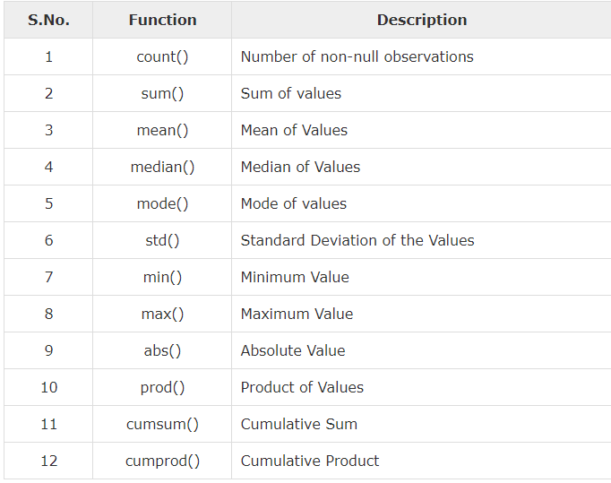
Descriptive Statistics
A large number of methods collectively compute descriptive statistics and other related operations on DataFrame.

Slide 28
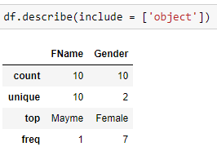
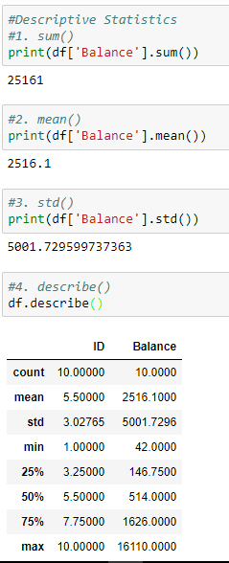
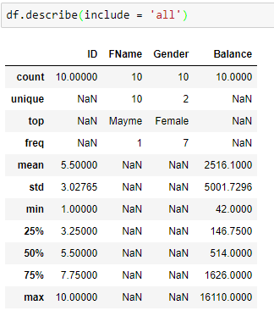
Descriptive Statistics

Slide 29
We’ll continue in next class..
Any questions?

